Slide 1
COARECT DMR Primer
COARECT - January
January 3rd 2026
Nolan Reisbeck – W7GXJ

Slide 2
DMR Overview
What we will cover:
  DMR Facts/Myths
  Terminology
  Brief History
  Topical theory
  How to get started
What we will not cover:
  How to program your radio
  Commercial (Trunked) System(s)

Slide 3
DMR Facts and Myths
“It’s Hard”/Steep Learning Curve
It’s not “real” radio
“It’s expensive to get started”
Requires the Internet to function

Slide 4
DMR: Introduction
Digital Mobile Radio – A Standard created by the ETSI for Voice and Data in non-public radio networks.
  ETSI: European Telecommunications Standards Institute
    GSM, 3G, 4G, 5G, TETRA
  Spectrum Efficiency!
    25 KHz Analog -> 12.5 KHz Digital; 4x density vs Conventional Analog; [W]FM, 2x NFM
    TDMA: Time Division Multiple Access (NOT FDMA)
  AMBE+2 Voice Codec
  Supports Data Frames for Text/E-Mail, GPS
  Built-in Error Correction, better weak signal behavior
  4,800 bps (data rate), 1,200 reserved for FEC (Forward Error Correction) -> 3,600 bps for voice/data
  Open Standard: Any manufacturer can produce a radio, if it meets the DMR Standards Doc(s), and sell
    Motorola, Kenwood, Anytone, Hytera, TYT, Retevis, BTech, Alinco, Radioddity, Baofeng
Notes:
ETSI: European Telecommunications Standards Institute; ETSI responsible for developing global communications technologies
Tetra: Terrestrial Trunked Radio TETRA was specifically designed for use by government agencies, emergency services, (police forces, fire departments, ambulance) for public safety networks, rail transport staff for train radios, transport services and the military. TETRA is the European version of trunked radio, simdilar to Project 25.

Slide 5
DMR: Introduction
Digital Mobile Radio – A Standard created by the ETSI for Voice and Data in non-public radio networks.
  TS 102 361-1: Air Interface Protocol (v2.5.1) 181 pg.
  TS 102 361-2: Voice and Generic Services (v2.4.1) 110 pg.
  TS 102 361-3: Data Protocol (v1.3.1) 57 pg.
  TS 102 361-4: Trunking Protocol (v1.11.1 2021-01) 311 pg.
Notes:
ETSI: European Telecommunications Standards Institute
DMR Standards defined in 659 pages of standards documents.

Slide 6
Rules To Remember
Rule 1: If something about DMR doesn’t make sense, you aren’t the intended audience.
  | non-public radio networks.
Rule 2: If it’s complicated, you’re overthinking it. See Rule #1.

Slide 7
DMR/PNW Digital History
2005: DMR Standards ratified by ETSI
2009: TRBO Online, 6 repeaters in Southern California (Los Angeles, San Diego, Riverside, San Bernardio)
  TRBO becomes TRBO-6
  Mike (WB6WUI/NO7RF) relocates from Costa Mesa -> Winthrop/Mazama Washington
2010: TRBO-6 becomes DCI
2011: NorCal C-Bridge Online, DCI C-Bridge Online
2013: TRBO-6 dissolves (politics), DCI is the main DMR Network in the United States
  More repeaters start popping up in the Seattle Washington area, PNW & I-5 Talk Groups created
  BC-TRBO joins the DCI C-Bridge
2015: Brandmeister online
  DCI leaves the MARC C-Bridge (more politics), decides to focus on the PNW Area of service, not Nationwide
  DCI rebrands/re-forms as WA7DMR or PNW Digital
2024: PNW Digital now have 90+ repeaters across Washington, Oregon and Idaho (plus Montana, California & British Columbia via Affiliate Groups (Mac Pass/DMR Montana, Inland Repeater Group, BC-TRBO)
Notes:
DCI: Digital Communications, Inc.

Slide 8
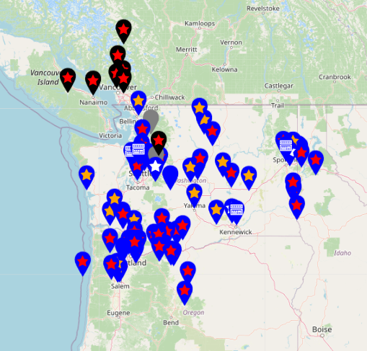
PNW Digital Repeater Map

Slide 9
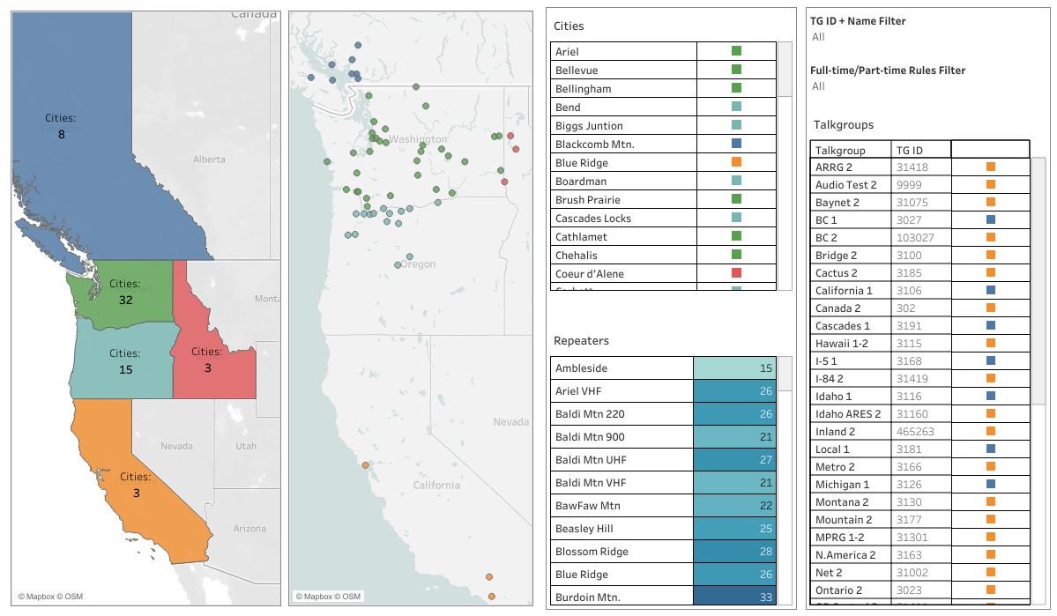
PNW Digital Repeater Map

Slide 10
DMR Terminology
DMR ID: Centrally Issued by RadioID.net Free to request
  24 bit (2²⁴) unsigned [0 - 16,777,215]
  ID identifies the operator, you; not the device. Majority of people will only ever need 1 DMR ID. You can use the same DMR ID on a handheld, multiple handhelds and a mobile/base station, they just cannot Tx at the same time.
    6 digit IDs for Repeaters
    7 digit IDs for Mobile/Base stations
    9 digit IDs == BAD. RadioID, Brandmeister recommend adding a 01, 02 suffix for hotspots, but this can break interoperability in some networks…
DMR Network: Group of linked (IPSC) repeaters
  DMR-MARC
  PNW Digital (Formerly TRBO, DCI TRBO, TRBO-6)
  BC TRBO
  DMR Texas
  BrandMeister
  TGIF
  Many more…

Slide 11
DMR Terminology Cont.
Talk Group: A 1-8 digit ‘room’ or logical grouping, it’s how traffic is organized in a DMR Network
  Talk Groups exist for:
    The Globe: World Wide 91 (Calling, Very brief QSOs)
    -> Continents: North America 93
    -> Countries: USA Bridge 3100, Ecuador 740, Spain 214
    -> Regions: Pacific Northwest (PNW) 3187, Spanish 914, Basque 971
    -> States: Oregon 3141, Texas 3148
    -> Sub-Regions: Pacific Northwest Regional (PNW-R) 31771, Central Oregon 31411, Western Oregon 31412, North Texas 31481, South Texas 31482
    -> Counties: Santa Clara County 31064, Sonoma County 31707
    -> Cities: Coeur d’Alene 5100
    -> Special Interests: Blind Hams 31679, FT-8 139, Sailing Hams 118, Venture Overland 31655
  Dynamic: Talk Group is keyed up by a user and after a fixed time, will drop.
  Static: Talk Group is always on.
Timeslot (TS): 1 or 2
  Wide Area Groups or Calling/Hailing generally use TS 1
  Local Area Groups or Tactical/Chat generally use TS 2
Color Code (CC): Numerical 0-15; CC 1, CC 2.. Analogous to CTCSS codes
  Think RGB 0-255: Red 0-255, Blue 0-255, Green 0-255 = 8 bits -> 2²⁴ -> 16 colors can be represented as 2⁴ = 16
  Channel MUST match repeater/radio Color Code to unsquelch
Notes:
CVS-12 USS Hornet NB6GC (NBGC) in Alameda California
- DMR ID 3169028
- https://www.facebook.com/NB6GC/
- https://nb6gc.org

Slide 12
DMR Terminology Cont.
Hotspot: A small ‘mini’ repeater, providing coverage to a very limited service area; 10-20 mW; great for your House, RV, or mobile in the car!
  Simplex: Tx/Rx on one Timeslot, always TS 2
  Duplex: Separate Tx/Rx chain, functions as an actual repeater, capable of Tx while Rx.
Code Plug: A data file that you load into your radio, generally from a computer.
Channel: A frequency pair + Time Slot + Contact/Talk Group
Zone: A logical grouping of Channels. Generally a Zone will contain all Channels that a Repeater carries.
Contact: A User (DMR ID) or Talk Group ID

Slide 13
DMR Tier 1 (Unlicensed)
“
DMR Tier I products are for license-free use in the 446MHz band. Tier I provides for consumer applications and low-power commercial applications, using a maximum of 0.5Watt RF power. With a limited number of channels and no use of repeaters, no use of telephone interconnects, and fixed/integrated antennas, Tier I DMR devices are best suited for personal use, recreation, small retail and other settings that do not require wide area coverage or advanced features.
“
Notes:
European PMR 446 band is similar to MURS/FRS in the United States

Slide 14
DMR Tier 2 (Conventional)
“
Tier II covers licensed conventional radio systems, mobiles and hand portables operating in PMR frequency bands from 66-960MHz. The ETSI DMR Tier II standard is targeted at users who need spectral efficiency, advanced voice features and integrated IP data services in licensed bands for high-power communications. ETSI DMR Tier II specifies two-slot TDMA in 12.5kHz channels.
“

Slide 15
DMR Tier 3 (Trunked)
“
DMR Tier III covers trunking operation in frequency bands 66-960MHz. The Tier III standard specifies two-slot TDMA in 12.5kHz channels. Tier III supports voice and short messaging handling similar to MPT-1327 with built-in 128 character status messaging and short messaging with up to 288 bits of data in a variety of formats. It also supports packet data service in a variety of formats, including support for IPv4 and IPv6.
“

Slide 16
DMR Tiers Compared
 | Tier 2 | Tier 3
Frequency | Fixed | Dynamic
Time Slots | Fixed | Dynamic
Management | Stun | Kill OTA Programming Firmware Updates Call Monitoring
Call Features | Individual Call Group Call All Call Broadcast Talking Party ID Late Entry | Priority Call Emergency Call Call Queuing PSTN/PABX Routing
Notes:
PSTN: Public Switched Telephone Network
PABX: Private Automatic Branch Exchange

Slide 17
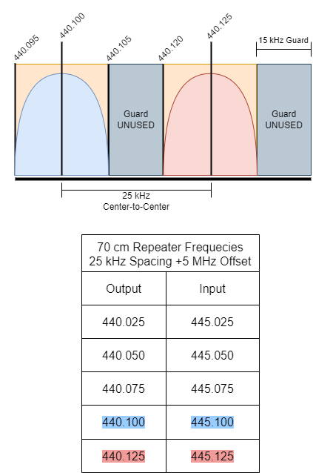
Analog FM Channel Anatomy
Analog 25 kHz Channel Spacing
  Two adjacent Wide FM Channels
  15 kHz guard channel to prevent interference

Slide 18
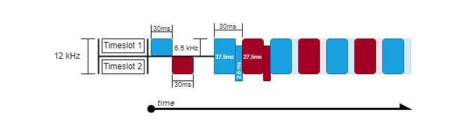
DMR Channel Anatomy
12.5 kHz width
Subdivided by Time, hence TDMA
Invisible to you!
Each Timeslot gets 30ms, your radio or the Repeater handles the keying/unkeying
Notes:
120,000ms in 2 minutes -> 4,000 ‘chunks’ of 30ms blocks
2.5ms block is for CACH burst: CACH -> Common Announcement Channel, used for timing, channel management, low-speed signaling
https://www.qsl.net/kb9mwr/projects/dv/dmr/Introduction%20to%20Digital%20Mobile%20Radio.pdf

Slide 19
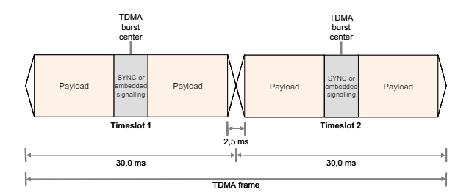
Mobile TDMA Frame
Time SYNC is embedded in the center of the payload
Entire TDMA Frame comprised of one TS 1, one TS 2 payload.
2.5 ms Guard timing to allow for power ramping, propagation delay
Notes:
Refer to TS 102 361-1

Slide 20
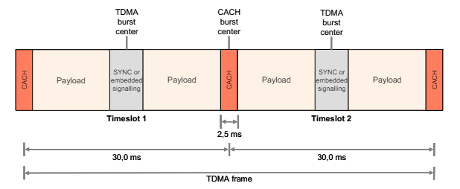
Repeater TDMA Frame
Time SYNC still embedded in the center of payload
2.5 ms timing guard replaced by a CACH (Common Announcement Channel) burst
CACH used for TDMA Frame Numbering, Channel Access Indicator, low speed signaling
Notes:
Refer to TS 102 361-1

Slide 21
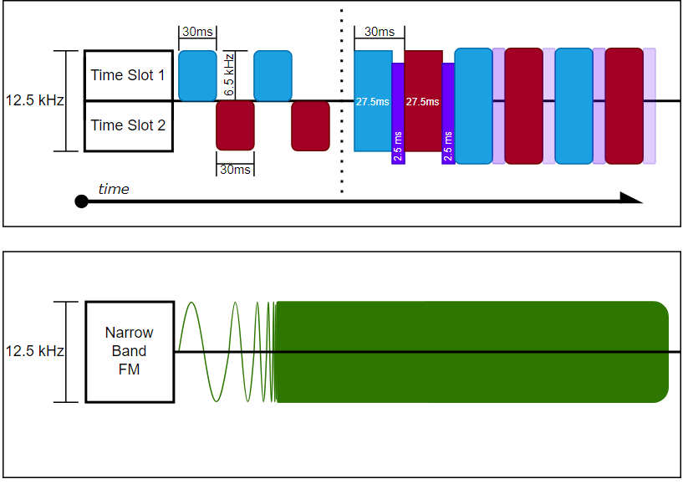
DMR Channel vs. Analog Channel
Two simultaneous conversations in 12.5 kHz for DMR
Analog: One conversation, you’re going to get bonked!

Slide 22
DMR Networks
Networks link repeaters together!
Similar to IEEE 802.x LAN
Repeaters link to a C-Bridge, this is the “brains” and handles the routing of traffic to other repeaters based on Talk Group(s)
Notes:
C-Bridge: Conference Bridge

Slide 23
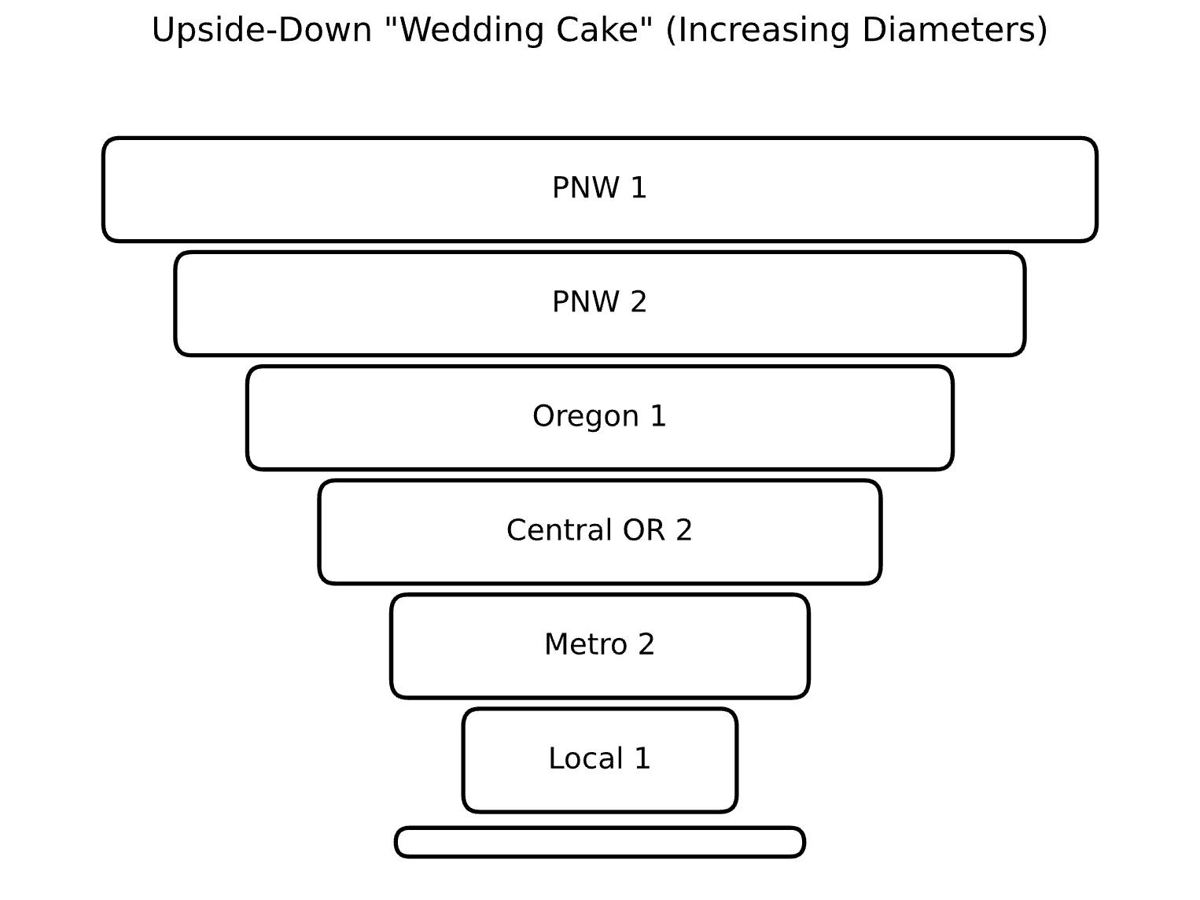
DMR Talkgroup Anatomy

Slide 24
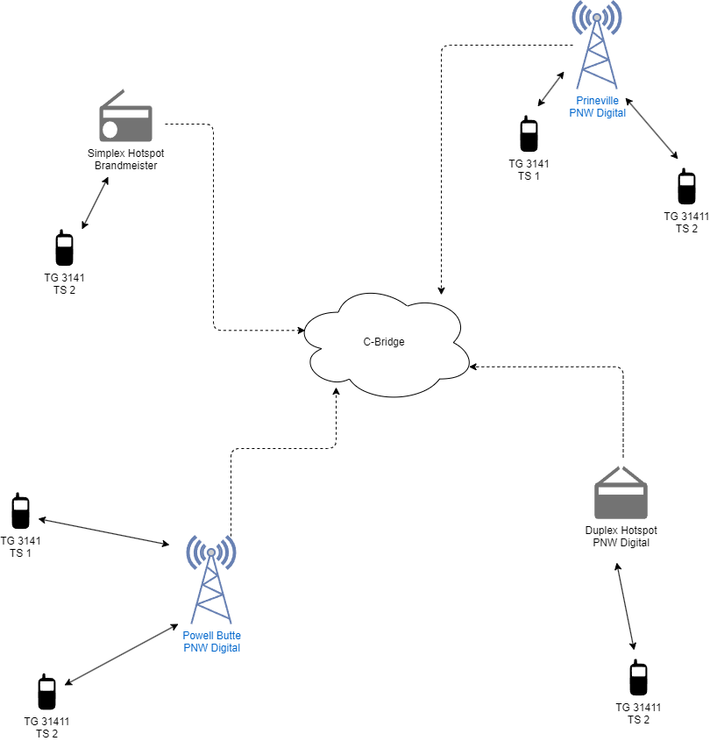
KI7FK
W7GLG
N7QME
KD6PLU
W7GXJ
KB7FD
Notes:
W7GXJ Calls W7GLG on Central Oregon 31411 for his turn on the HiDARG DMR Net
Prineville Repeater carries 31411 F/T so W7GLG hears it
KB7FD’s Hotspot is active so KB7FD hears the call

Slide 25
KI7FK
W7GLG
N7QME
KD6PLU
W7GXJ
KB7FD
Notes:
W7GLG answers W7GXJ from Prineville Repeater, he’s busy eating supper so he’ll be In & Out tonight

Slide 26
KI7FK
W7GLG
N7QME
KD6PLU
W7GXJ
KB7FD
Notes:
N7QME Calls out on Oregon 1 3141, “Anyone listening in the Central Oregon area?”
Oregon 1 is F/T on both Powell Butte and Prineville
KD6PLU hears the call on Powell Butte
KI7FK hears the call on Prineville

Slide 27
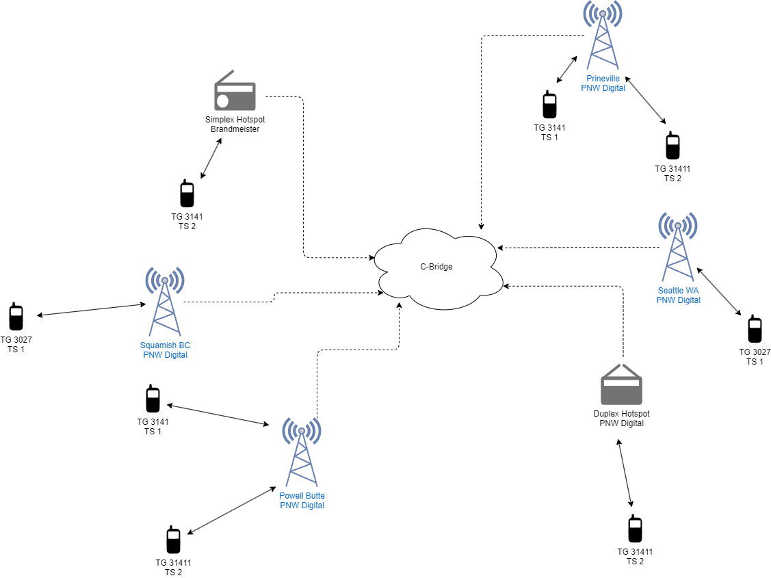
KI7FK
W7GLG
N7QME
KC7BD
KD6PLU
K7PSY
W7GXJ
KB7FD
Notes:
W7GXJ moves on to the next person on the list KB7FD

Slide 28
KI7FK
W7GLG
N7QME
KC7BD
KD6PLU
K7PSY
W7GXJ
KB7FD
Notes:
KB7FD responds to the net, regales us with tales of his move and how nice the weather is down in California

Slide 29
KI7FK
W7GLG
N7QME
KC7BD
KD6PLU
K7PSY
W7GXJ
KB7FD
Notes:
KB7FD still talking to net
KD6PLU answers to N7QME on Oregon 1 3141
KI7FK still monitoring on the Prineville Repeater

Slide 30
KI7FK
W7GLG
N7QME
KC7BD
KD6PLU
K7PSY
W7GXJ
KB7FD
Notes:
K7PSY (Pat) is travelling in the Seattle Washington area, decides to see if he can get someone up in Vancouver BC

Slide 31
KI7FK
W7GLG
N7QME
KC7BD
KD6PLU
K7PSY
W7GXJ
KB7FD
Notes:
K7PSY is travelling in the Seattle Washington area, decides to see if he can get someone up in Vancouver BC
KC7BD (Dave) appears to have taken a little road trip up to Squamish, and hears him on BC 1 3027, responds to K7PSY (Pat)

Slide 32
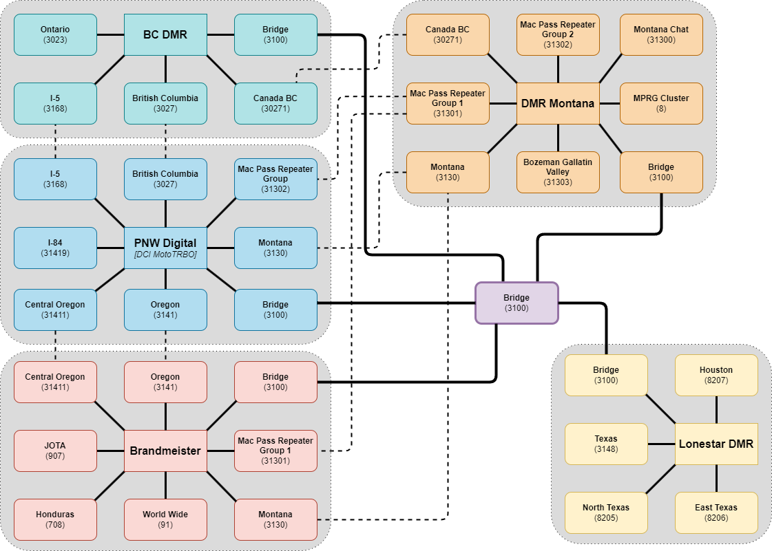

Slide 33
DMR Handheld Comparison
 | Alinco MD5T | Anytone D878UVII Plus | BTech 6X2 | TYT MD380
Contacts | 160,000 | 500,000 | 200,000 (500,000 Pro)
Talk Groups | 10,000 | 10,000 | 10,000
Channels | 4,000 | 4,000 | 4,000 | 3,000
Zones | 250 | 250 | 250
Power | 0.2, 1, 2.5, 5 W | 1, 2.5, 4, 7 W | 1, 2.5, 5, 7 W | 1, 5 W
Battery | 1,700 mAh | 3,100 mAh | 2,100 mAh | 2,000 mAh
Frequency | 2m, 70cm | 2m, 220, 70cm | 2m, 70cm | 2m, 70cm
Weather |  | IP-54 Dust/Water | IP-54 Dust/Water
APRS | No | A+D Tx & Rx | A+D Tx/Rx | No
Bluetooth | No | Yes | Yes | No
Price | $189 | $314.99 ($220) | $210.00 ($299 Pro) | $95.99

Slide 34
DMR Simplex
Standards:
TG 99 , CC 1, TS 1
VHF:
145.5100
145.7900
UHF:
441.0000
433.4500
446.0750
446.5000

Slide 35
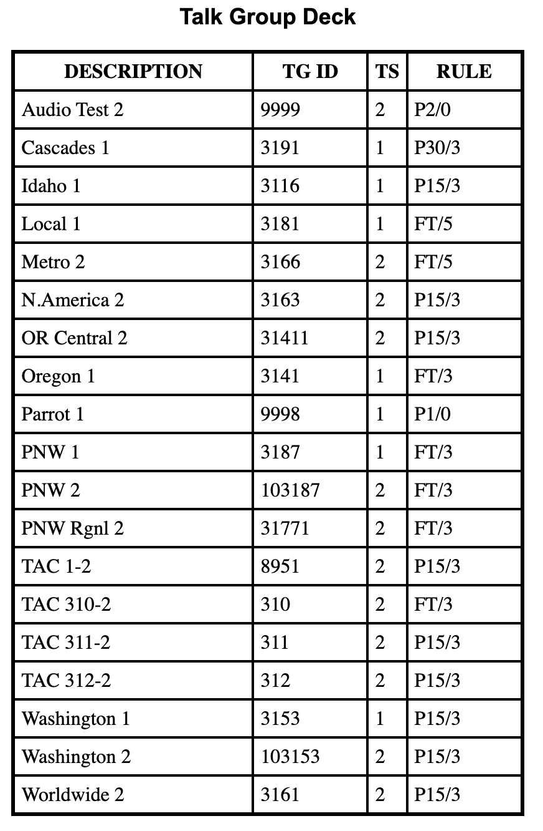
Talk Groups
Full Time, Part Time?
Full Time: Always on. Turn on your radio, select the channel and you will hear traffic.
Part Time: Activity activated, need to ‘kerchunk’ to turn on. Will time out after a period of no activity.
  Two operators could be having a QSO on different repeaters, a third could turn their radio on, select that Talk Group and hear nothing…
  Through Brandmeister, on a hotspot all Talk Groups are Part Time/Dynamic by default unless you have set static TGs on your hotspot or through Brandmeister Self-Care.
  P15/3
    Part Time, will drop after 15 minutes, unless you kerchunk, 3 minute hold-off (will lock out all other Timeslot traffic for 3 minutes.

Slide 36
How To Get Started?
Obtain a DMR ID from RadioID.net, it’s free!
Purchase a DMR Handheld or Mobile $50-$300
  (Optional) Purchase a Hotspot $100-$200
Program your Radio
Get on the air!

Slide 37
Why Choose DMR?
Relatively lower cost for new Hams, compared to HF
Worldwide contacts with only a Technician class license
Lots of nets to choose from across different networks & niche interests
Very good support in the PNW area, PNW Digital has great learning resources

Slide 38
DMR Nets
HiDARG DMR Net – Tuesday 18:30 Central Oregon (31411) PNW+BM
PNW Happy Hour – Monday-Friday 17:00 Oregon 1 (3141) PNW+BM
Not-A-Net – Wednesday 19:00 PNW Regional (31771) PNW+BM
  Technical questions (DMR) on Zoom following radio net
Cascades Coffee Net – Monday/Wednesday/Friday 0800 (3191) PNW Only
RVers Net – Sunday 1800 (BM TG 31012)
Oregon Statewide – Monday 1900 Oregon 1 (3141) PNW+DM

Slide 39
Nearby Repeaters
W7GXJ/R – PNW Digital
  Powell Butte -- 440.9375 +5 CC1
K7RPT (ARRG )– PNW Digital
  Prineville/Grizzly -- 440.5750 +5 CC1
N7CCO – PNW Digital
  Prineville – 441.2500 +5 CC1
K7PN/R – PNW Digital
  Government Camp/Mt. Hood -- 444.1500 +5 CC1
KC7DMF/R – Brandmeister
  VHF Long Butte -- 147.2800 +0.6 CC1
  UHF Long Butte -- 444.450 +5 CC1
KB7APU/R – SAR DMR (please see https://sardmr.com/talkgroups)
  Gray Butte -- 442.9500 +5 CC1 (NE of Redmond/Terrabonne)
  Government Camp -- 442.9875 +5 CC1
N7MAQ/R – PNW Digital
  Dallas/Rickreall -- 442.8875 +5 CC1
W7OEC/R – Brandmeister
  Eugene – 442.42500 +5 CC1
KC7RJK/R – Brandmeister
  Eugene – 444.4250 +5 CC1
Notes:
12 within 100 mi of Bend
N7CCO: Ochoco Amateur Radio Association
N7RPT/ARRG: Amateur Radio Relay Group

Slide 40
Questions?

